Slide 1

Department of Computer Science and Engineering Internship Seminar(17CS84) on Secure And Interactive Online Cab Booking Portal Using Springs MVC Framework and Hibernate INTERNAL GUIDE EXTERNAL GUIDE PRESENTED BY Mrs. Priyanka Padki Mr. Chaitanya R Narendranath Reddy Assistant Professor, Technical Head, 1BG17CS075 Dept of CSE, BNMIT Glisten Project Solutions Pvt Ltd 8B CSE Bangalore Bangalore Date:05/06/2021
B.N.M. Institute of Technology

Slide 2
AGENDA
Company Profile
Objective
Introduction
Project Task
Technology Stack
Results and Impact
Conclusion

Slide 3
COMPANY PROFILE
Glisten Education(GE) is one of the leading training institutes and tops in the list of IT Educational Companies.
Glisten Projects is incepted in the year 2011, by a team of highly qualified technocrats with a vast experience in Electronic System Design & Sales in Techno-Commercial field and other Industries as well.
Vision:
Be a globally recognized training Institute in the field of Engineering and Information
Technology Education.
Mission:
Facilitate educational access and academic excellence through exceptional management
of operations and resources, innovative delivery systems, student services and relevant
academic programs that are success oriented and responsive to technology

Slide 4
PROPOSED SYSTEM
The application is primarily designed to book cabs between an entered source and destination along with vehicle of our choice. It has all the basic facilities that are required by a user to have a convenient and hassle free online booking experience
The key features includes:
Secure and Interactive Webpage: The use of Spring MVC Framework for the development of application enables secure and authorised access.
Robust and Scalable: Uses cutting-edge technology for efficient storage in the database.It can upgrade according to the capacity needs.
Innovation: Uses many intelligent systems that aid in automatic dispatch and assigning optimal drivers.

Slide 5
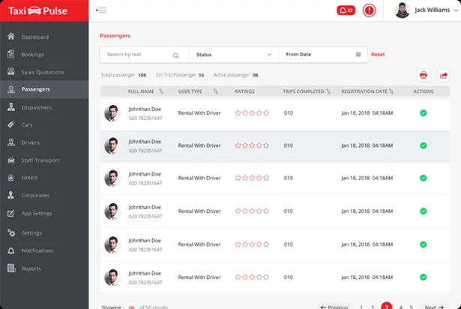
CORE FUNCTIONALITIES
ADMIN PANEL
Manage Passengers
Admin is responsible for managing the passengers registered on the system. Admin can add/view/modify/remove the passenger details anytime.
View passenger details
View booked trips details
Edit details
Add/delete passenger details

Slide 6
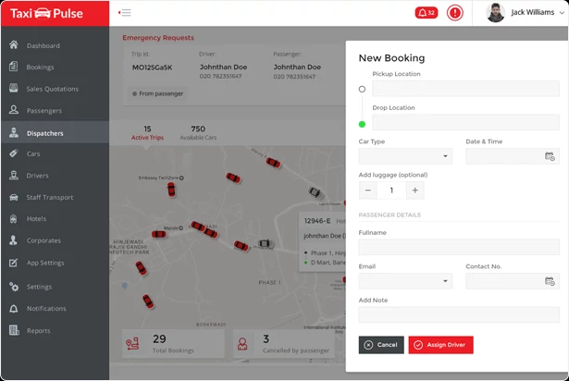
Manage Dispatcher
An admin can manage the dispatcher who can handle booking requests. It can assign the roles to dispatchers and operators. The dispatcher can manage the drivers’ tasks accordingly.
Assign Dispatcher roles
Add/modify delete dispatchers
View and track dispatcher activities

Slide 7
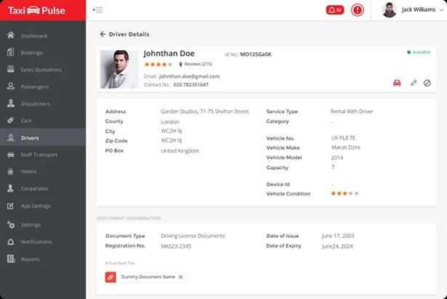
Manage Drivers
Admin is responsible for managing the drivers registered on the system. Admin is able to add/modify /delete drivers anytime. It can accept or reject a driver’s account. Only admin approved driver accounts can get online.
Review vehicles and documents added by drivers
Approve/reject driver’s account
Add vehicle type
Add driver vehicles

Slide 8
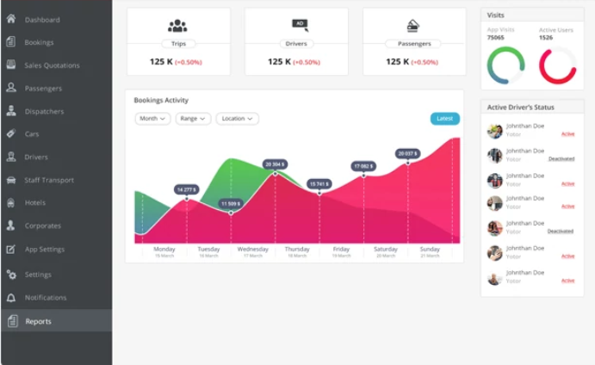
Reporting Analytics
A report section where Admin can view various reports like Total Earning Report, Payment Report, User wallet Report, Referral Report, Drive Log and Payment Report etc.
Check key insights and numbers
Check how much you are earning
Check whether to increase/decrease commission

Slide 9
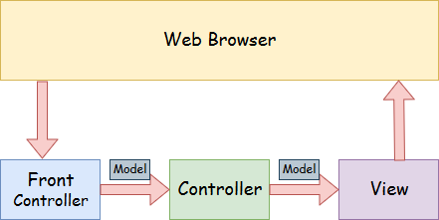
TECHNOLOGY STACK
Java Spring MVC Framework
A Spring MVC is a Java framework which is used to build web applications. It follows the Model-View-Controller design pattern. It implements all the basic features of a core spring framework like Inversion of Control, Dependency Injection.

Slide 10
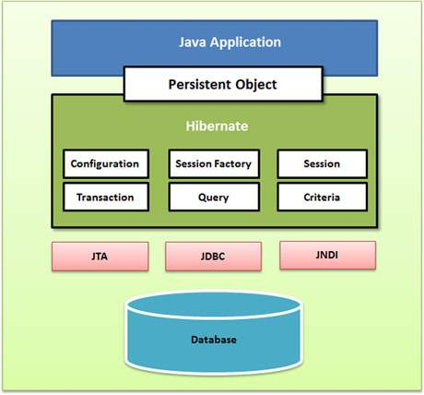
Hibenate
Hibernate is framework that provides tools for object relational mapping (ORM).
The web application uses the Hibernate framework as the persistence layer for retrieving and storing plain old Java objects (POJOs) to a relational database.

Slide 11
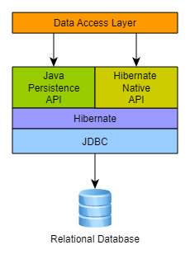
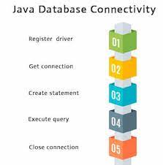
JDBC
The sample configuration file uses Hibernate-managed JDBC connections. JDBC is a standard API specification developed in order to move data from frontend to backend.
This API consists of classes and interfaces written in Java. It basically acts as an interface (not the one we use in Java) or channel between your Java program and databases i.e it establishes a link between the two so that a programmer could send data from Java code and store it in the database for future use.

Slide 12
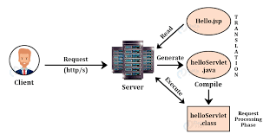
JSP (JAVA SERVER PAGES)
It is a server side technology.It is used for creating dynamic web application.JSP tags are used to insert JAVA code into HTML pages.
JSP is first converted into servlet by JSP container before processing the client’s request.

Slide 13
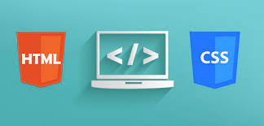
HTML & CSS
HTML (the Hypertext Markup Language) and CSS (Cascading Style Sheets) are two of the core technologies for building Web pages. HTML provides the structure of the page, CSS the (visual and aural) layout, for a variety of devices. Along with graphics and scripting, HTML and CSS are the basis of building Web pages and Web Applications.

Slide 14
KEY TAKEAWAYS
Gained knowledge on key-edging technologies like Springs and Hibernates .
Explored on all the aspects dealing with practicality and feasibility of the project application.
Acquired adequate insights about the various roles and the model of a real-time online cab booking system
Learned excessively on facing the challenges encountered in the integration and deployment of the application.
Peer-reviews and team work strategies was exercised that resulted in developing an uncompromisable solution.

Slide 15
Thank You !

